Slide 1

Understanding and Controlling Memory in Recurrent Neural Networks
Doron Haviv, Alexander Rivkind, Omri Barak
Presentation:
Zahra Mousavi Movahed
Amir Mohammad Ranjbar Pazoki

Slide 2
Task Definition
Inputs :
A series of noisy images, among which appears a single target image at time Ts
A response trigger at time Ta
Ts : stimulus time
Ta : response time
Ts, Ta are chosen randomly at each trial from a uniform distribution on [1, Tmax ] subject to the constraint Ta − Ts > 4
Each pixel of the noise mask was sampled from a Gaussian distribution
Outputs :
Label of image as time Ta, NULL at all other times

Slide 3
Model
MNIST Dataset
Number of classes : 10
Layers:
Input layer :
N neurons where n is the number of pixels in the image
1 neuron for the response trigger
Recurrent layer: a single recurrent layer of 200 gated recurrent units
Output layer:
10 neurons for the different classes
1 neuron for the null indicator
Gated Units: GRU, LSTM
Optimizer: Adam
Loss function: soft-max cross-entropy

Slide 4
Model
CIFAR10 Dataset
Number of classes : 10
Layers:
Input layer :
N neurons where n is the number of pixels in the image
1 neuron for the response trigger
Convolutional frontend: three convolutional layers and two dense layers
Recurrent layer: a single recurrent layer of 400 gated recurrent units
Output layer:
10 neurons for the different classes
1 neuron for the null indicator
Gated Units: GRU, LSTM
Optimizer: Adam
Loss function: soft-max cross-entropy

Slide 5
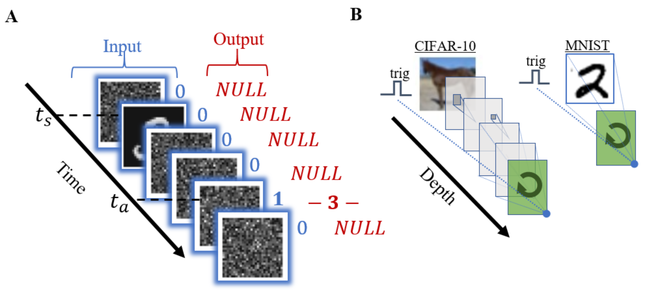

Slide 6
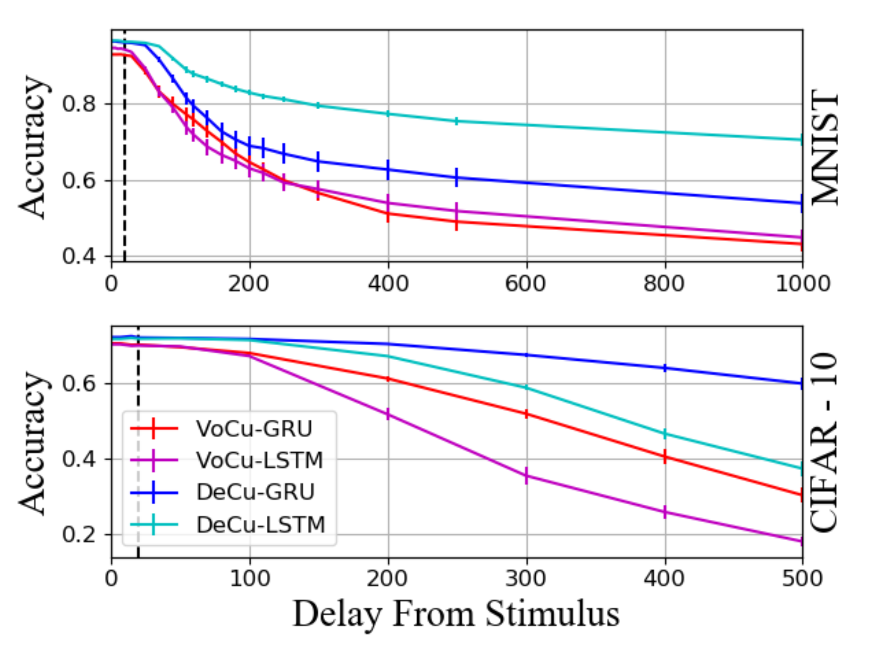
Training Protocols
Vocabulary Curriculum (VoCu)
Started from two classes V = {c1,c2} and then increased the vocabulary gradually until reaching the full class capacity
Delay Curriculum (DeCu)
Started from short delays between stimulus and reporting times (Tmax = 6), progressively extended it toward the desired values

Slide 7
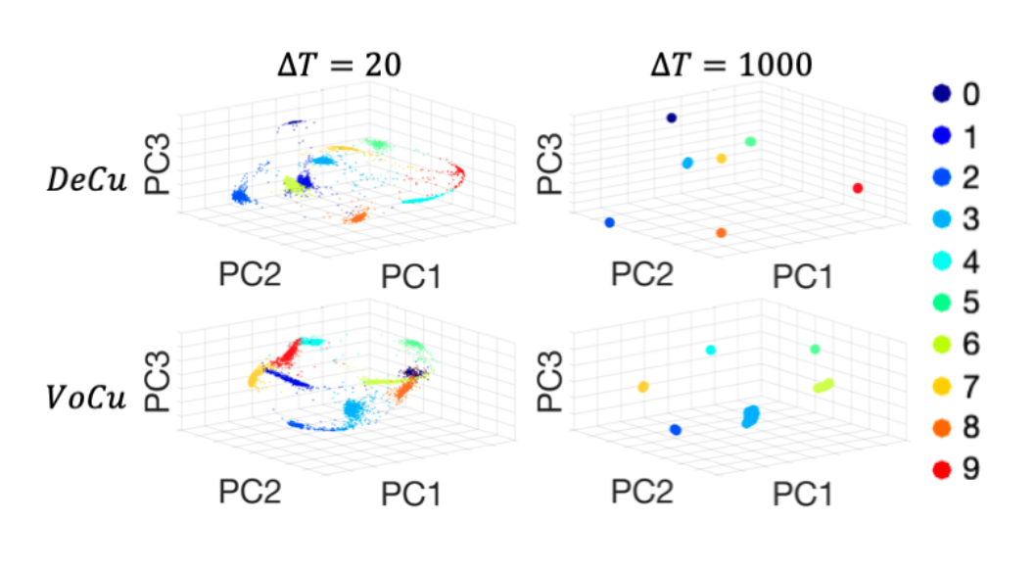
Dynamics of hidden Representation

Slide 8
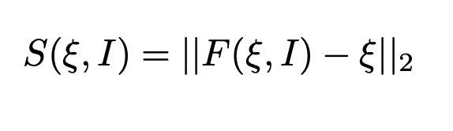
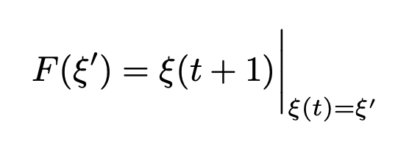
Dynamics of hidden Representation
Define Speed:
ξ = the state of the recurrent layer
I = average of the noise images

Slide 9
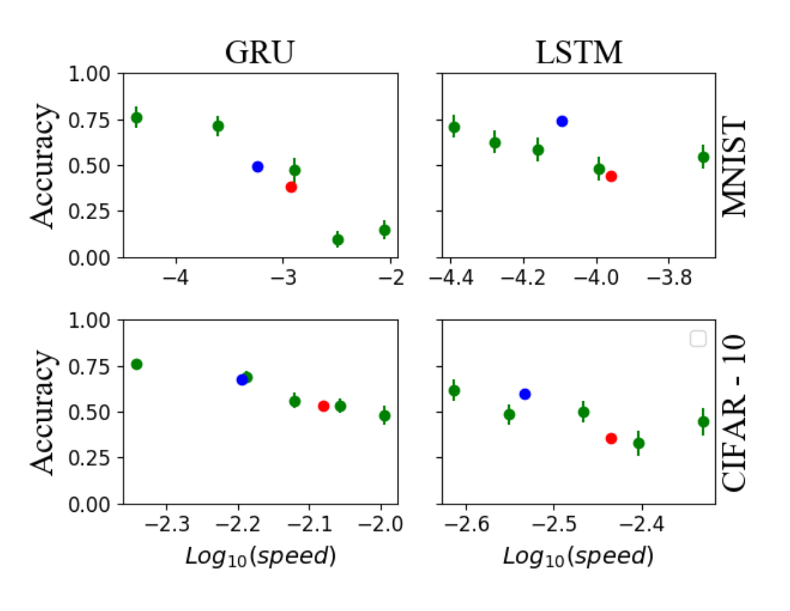
Extrapolation accuracy predicted by slow point speeds. The accuracy at long delays
(∆t = 1000 for MNIST and ∆t = 500 for CIFAR-10)

Slide 10
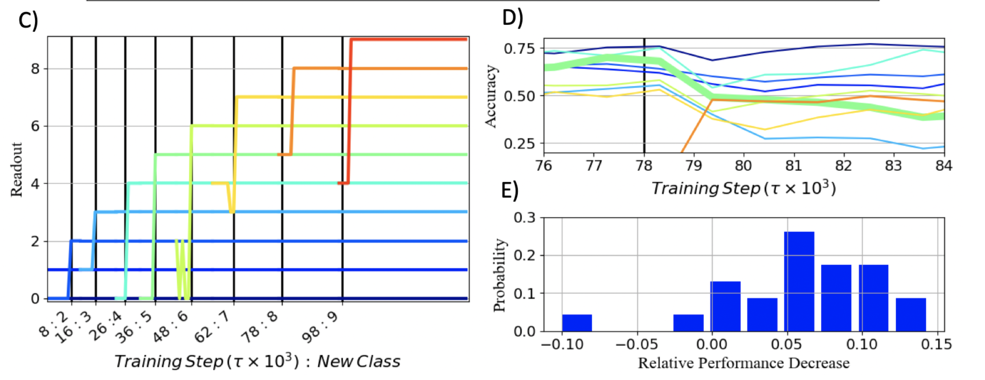

Slide 11
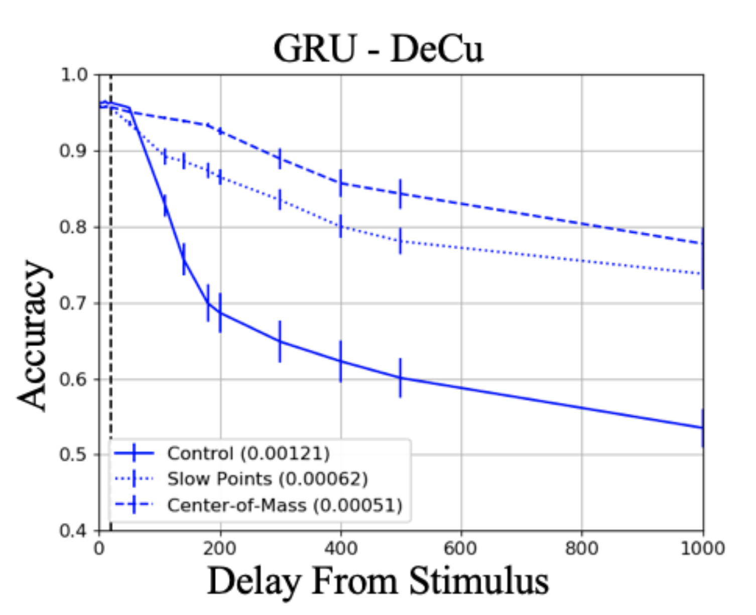
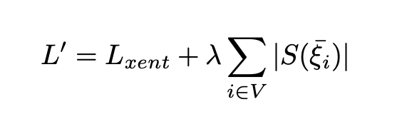
Improving Long Term Memory
New Loss:

Slide 12
Thank You for Your Attention

